Slide 1
EDES 301 “Door Logger” Project Proposal (cooler name TBD)
4/22/25 5/16/25
Austin Burke

Slide 2
Background
Why am I doing this

Slide 3

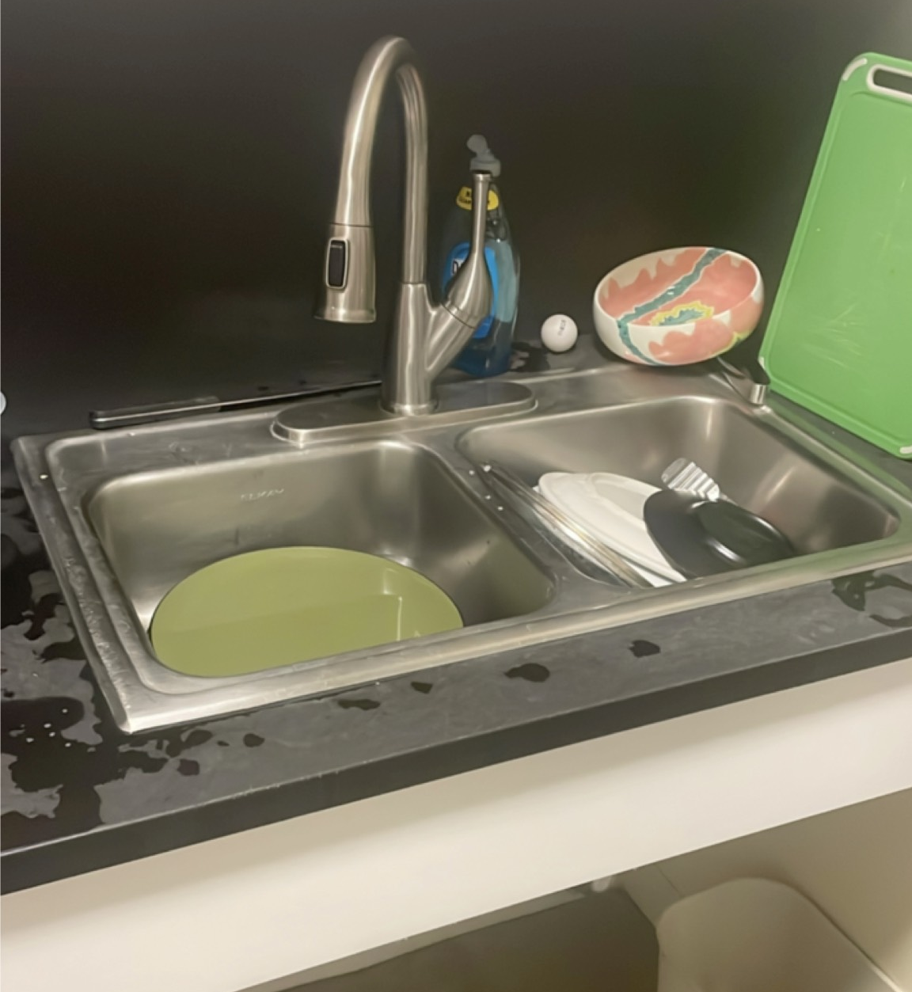
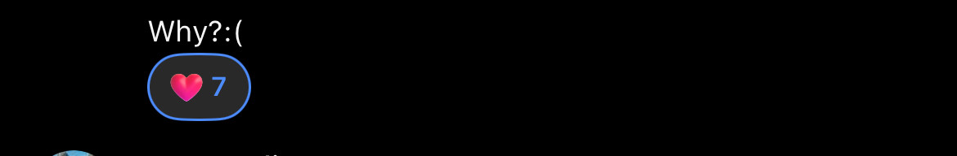

The Problem
People keep leaving dirty dining hall plates in the public kitchen sinks at McMurtry college
This is gross
McMurtry receives a fine for every plate that H&D staff have to return to the server (and it ADDS UP)
How can we disincentivize people from engaging in this behavior?
And, for my own curiosity, WHO is doing this?

Slide 4
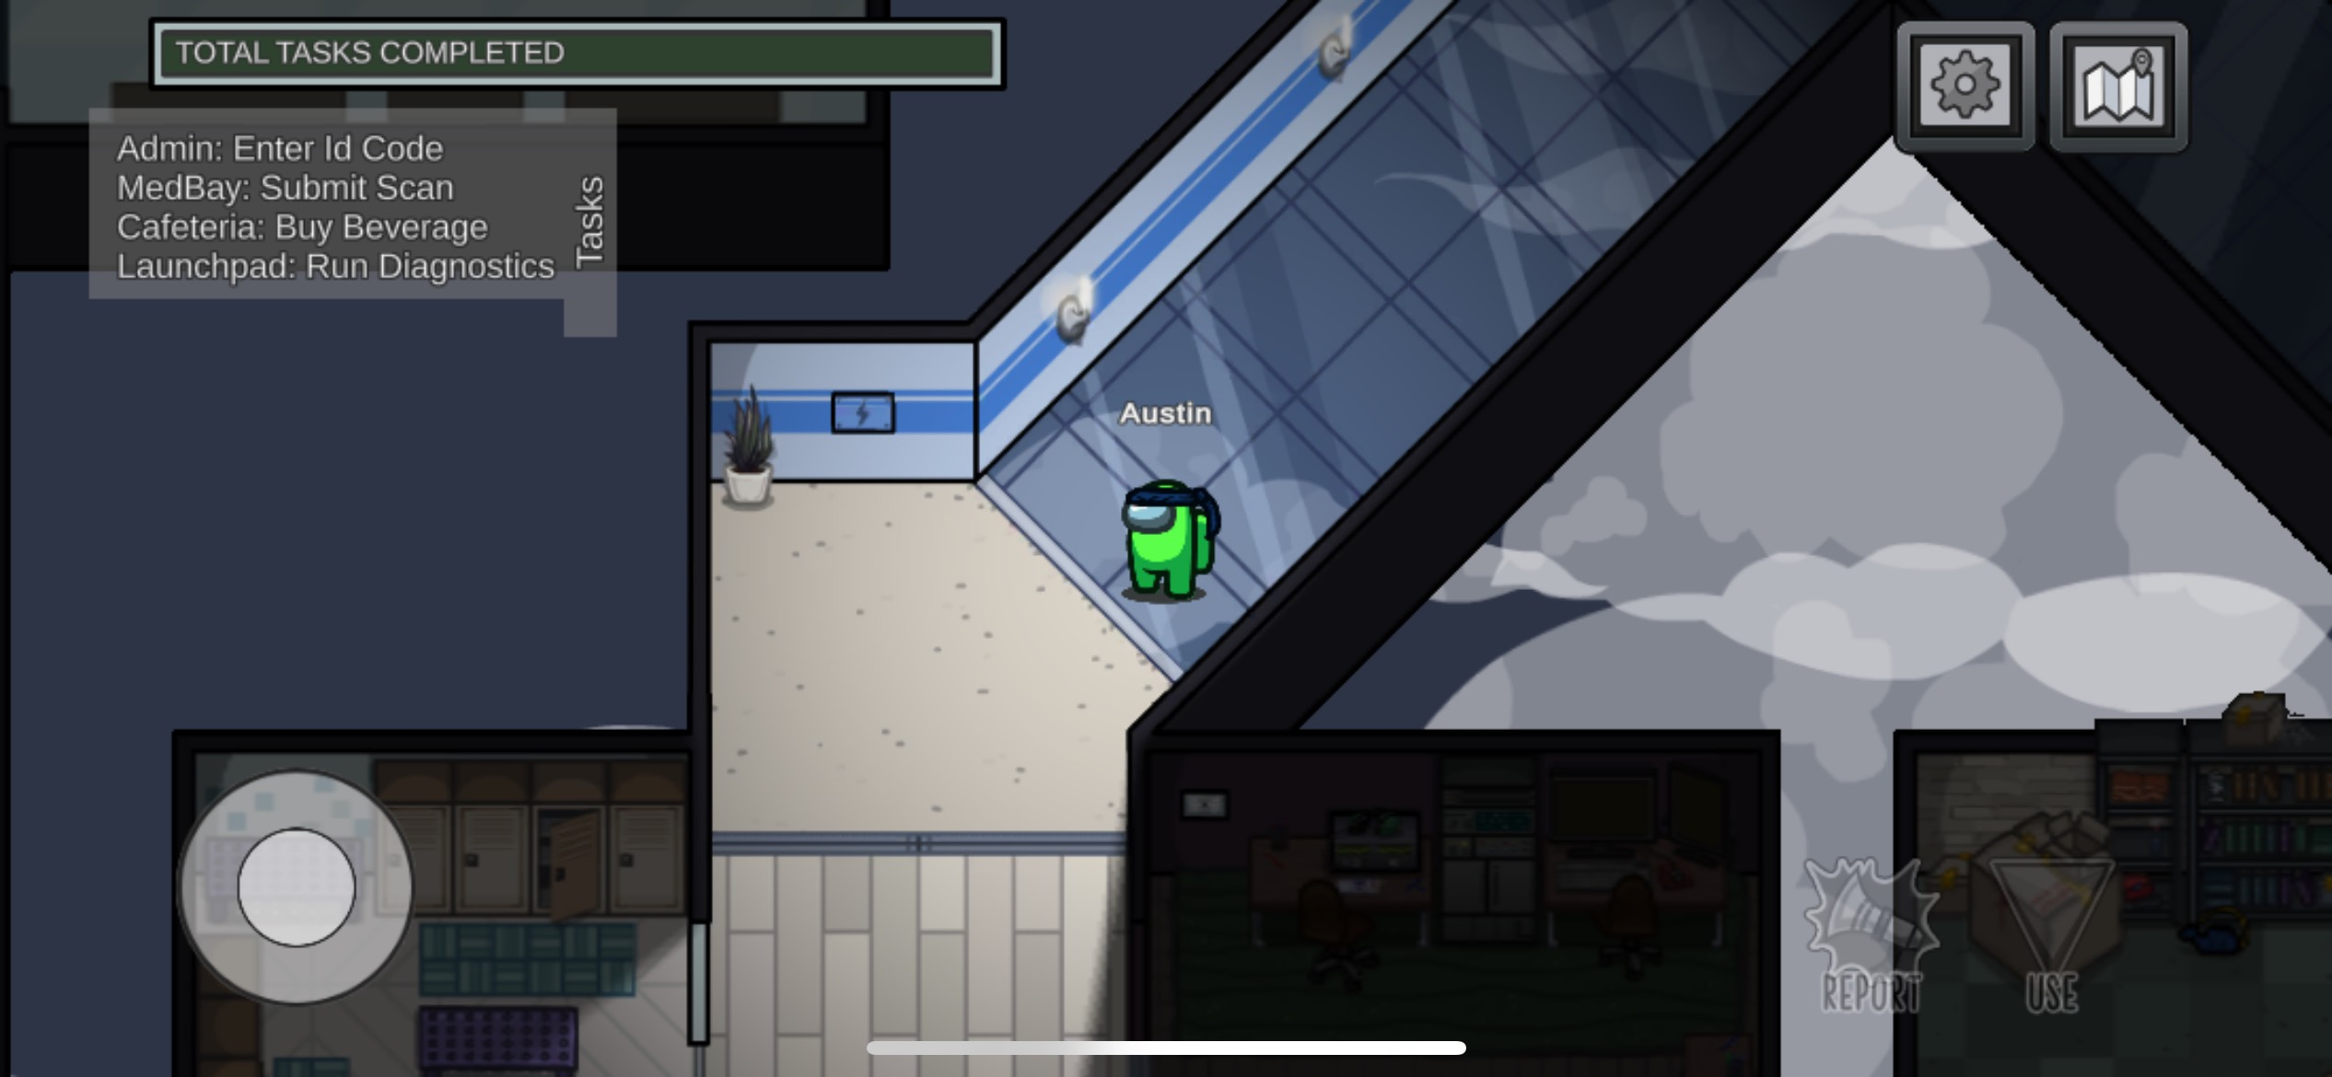
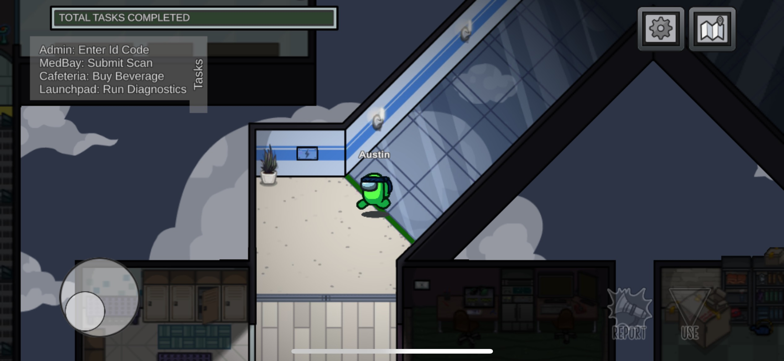
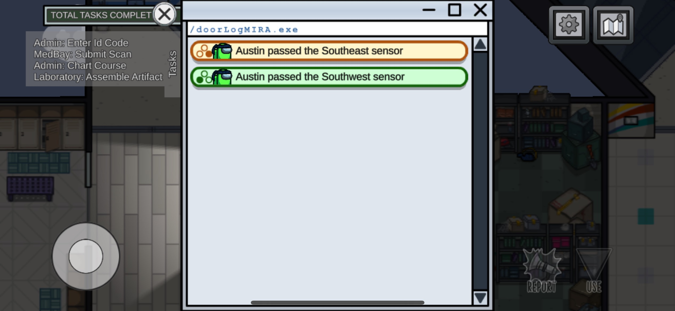
Inspiration
In the Mafia/Whodunit style videogame Among Us, players must deduce and vote out a murderer among their ranks
One of the maps features a “door tracking” mechanic
Players can utilize the time and place from the data to help them make deductions and determine suspects

Slide 5
The Introvert’s Solution
Okay, so I can’t exactly build a device that identifies people when they walk into the kitchen
…no matter how funny as it would be to take secret photos and publicly shame people in the college group chat…
But I do want to gather “data” about kitchen traffic
How often do/how many people use my floor’s kitchen?
If relatively few people use it, I can likely figure out the regulars
How long do people stay?
Is there a correlation between use time and likelihood to leave a mess?
What other interesting (possibly unrelated) patterns can I find?
Additionally, I could devise a secondary sensor to detect activity in front of the sink
Ideally, there’s a software component that can send me an email (or at least record and transfer data)

Slide 6
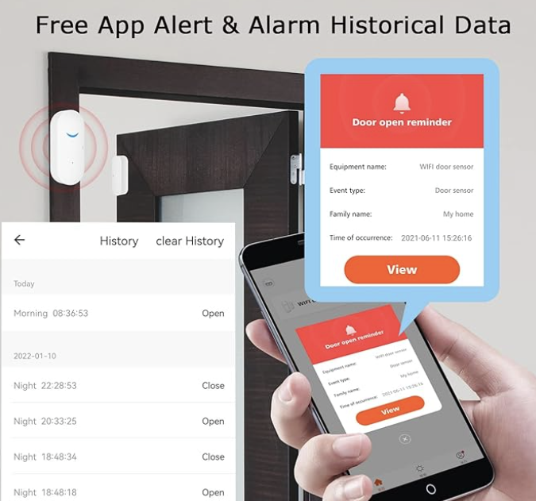
Existing Projects/Products
Autodesk Instructables – DIY Door Alarm
https://www.instructables.com/Super-simple-door-alarm/
Tuya WiFi Door Sensor (one of many example products…)
https://www.amazon.com/dp/B08T71GDSN?th=1
Uses magnetic reed switch (I will too probably) and records openings
Raspberry Pi Forums w/ GitHub Links - Door Access System
https://forums.raspberrypi.com/viewtopic.php?t=255772
The inverse of what I’m doing, but still interesting
My Addition(s)
Secondary activity sensor (IR break-beam) to make inferences about activity and/or to distinguish between entrances and exits
More in-depth logs/data
Local processing capability w/ PB (e.g. door opens but the IR break-beam sees nothing → don’t send data)

Slide 7
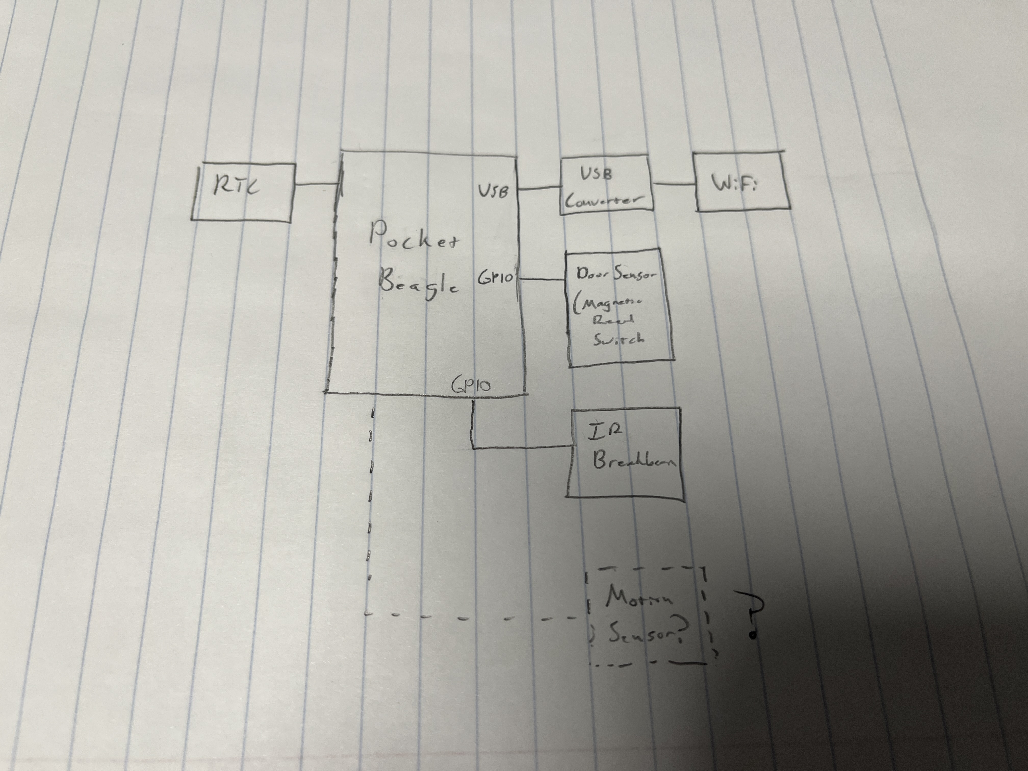
System Block Diagram
Micro USB
USB Converter
USB
WiFi
Adapter
RTC
I2C
Pocket
Beagle
Door Sensor (Reed Switch)
GPIO
GPIO
Secondary Sensor (IR Break-beam)
GPIO?
Possible Tertiary Sensor (Motion Sensor?)

Slide 8
Power Block Diagram
Pocket
Beagle
3.3V Components
Low current draw
Door Sensor (Reed Switch)
3.3V
SYS_3.3V
3V
RTC
Button Battery
Power Supply Up to ~500mA current
Secondary Sensor (PIR)
5V Components
~50uA current draw
Laptop
5V
SYS_VOUT
Tertiary Sensor (PIR)
5V
USB-A
Micro USB
5V
SYS_VOUT
5V, ~100 mA avg current req; ~300 max current req.
USB Converter
WiFi
Adapter

Slide 9
Components / Budget
Component | EDES301 to Buy? | Link | Cost | Comments
USB WiFi | No | https://a.co/d/3VMmDoP | $9.97
USB Converter | No | - | $0.00 | In Box Already
Magnetic Reed Switch | No | https://a.co/d/dOzEkcA | $9.99
Motion Sensor | No | https://a.co/d/cpk4WgP | $7.29
SparkFun RTC Module - RV-8803 | No | - | $18.95 | Out of budget
Real time clock (sketchier but way cheaper) | No | https://a.co/d/89dxzb6 | $7.99 | Hoping I get one of the more accurate chips.
Button batteries | No | - | Free | Already owned
IR Break Beam | No | - | - | Can’t find any of necessary range within budget. Plus, I could just use another one of the motion sensors

